Slide 1

Artificial Intelligence Laboratory
Presentation Name : News Classification
Course Title: Artificial Intelligence Laboratory
Course Code: CSE 318

Slide 2


Our Teacher Details
ARTIFICIAL INTELLIGENCE
Instructor: Md. Ataur Rahman (AR)
Email address: shaoncsecu@gmail.com
Institution: Department of Computer Science and Engineering,
Premier University
Work Experience
Prerequisite: CSE 111 (Structured Programming) or instructor's consent.
Session: Fall 2020

Slide 3


Infographic Style
Team Name: Spy_FS
Meet Our Team Member
At a glance
Sadia Chowdhury Dola
Fariha Chowdhury Bristy
ID: 1703310201465
Sec: B
ID: 1703310201445
Sec: B
Student
Student

Slide 4

Contents
01
Introduction
Get a idea of Artificial Intelligence.
02
Working Procedure
Get a working area of Artificial Intelligence.
03
System Output
Get a output on the model.
04
Conclusion
Get a information about all.

Slide 5
Section
Break
News Classification

Slide 6

Introduction
Artificial Intelligence
Machine learning (ML) is the study of computer algorithms. Support Vector Machine and Naive Bayes classifier is a classification of ML in supervised learning. Those algorithm are quite popular to be used in NLP. Support Vector Machine gives better accuracy than KNN, Decision Trees and Naive Bayes Classifier and hence is quite useful.

Slide 7
Artificial Intelligence
Model Classifier
What is Naive Bayes Classifier?
What is Support Vector Machines ?
Naive Bayes classifiers have high accuracy and speed on large datasets.
Support Vector Machines is considered to be a classification approach and regression problems. It can easily handle multidimensional space to separate different classes.
Naive Bayes Classification Workflow
The classification has two phases, a learning phase, and the evaluation phase.
Support Vector Machines Classification Workflow
SVM is to find a maximum marginal hyperplane(MMH) that best divides the dataset into classes.

Slide 8
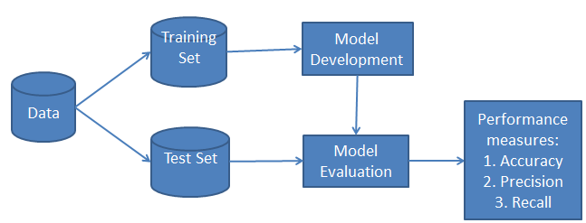
News Classification
Classifier Workflow

Slide 9

ARTIFICIAL
INTELLIGENCE
Working Procedure
News classification
Datasets
Pre- processing
All functions

Slide 10
Two Columns
01
Datasets
For the project, we are using the dataset containing about News Classification datasets. The reviews came from four classes (Business, Sci_Tech, Sports, World). The actual training data (‘train.txt’) contains a total of 1,20,000 reviews while the test/development data (‘dev.txt’) contains around 4,600 labelled examples. Also encoding ‘utf-8’. The training data is so large ,so we took 15,000 labelled examples to improved our model.
02
Pre-Processing List
Remove URL
Remove Hashtag
Remove Whitespaces
Tokenize Sentence
Remove Punctuation
Remove Stopwords
Apply Stemmer
Lemmatize Word.

Slide 11
How Can We Improve Our Model?
LET”S START

Slide 12

01
Presentation with News Classification Datasets
Separate Labels
Separate the labels/class and examples/documents from the dataset and split the whole document where it gets a tab
Read Files
Read text data from a file in the drive, also encoding='utf-8‘.
Google Drive
Mounted at /content/drive.
Step 4
Import Library
Necessary libraries download and import. For example, sklearn, nltk, MultinomialNB, Pipeline etc.
Step 3
Step 2
Step 1

Slide 13
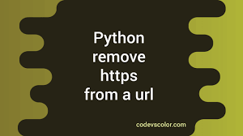

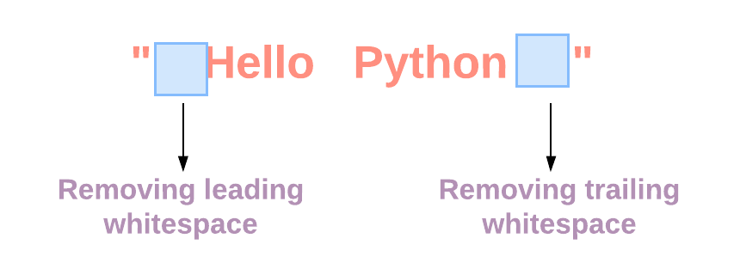
News Classification
02
Pre-Processing
Remove URL, Remove Hashtag & Remove Whitespaces
Removes URL's from Texts
Remove all occurrences of # from the texts
Removes multiple whitespaces and replace them with a single whitespace

Slide 14
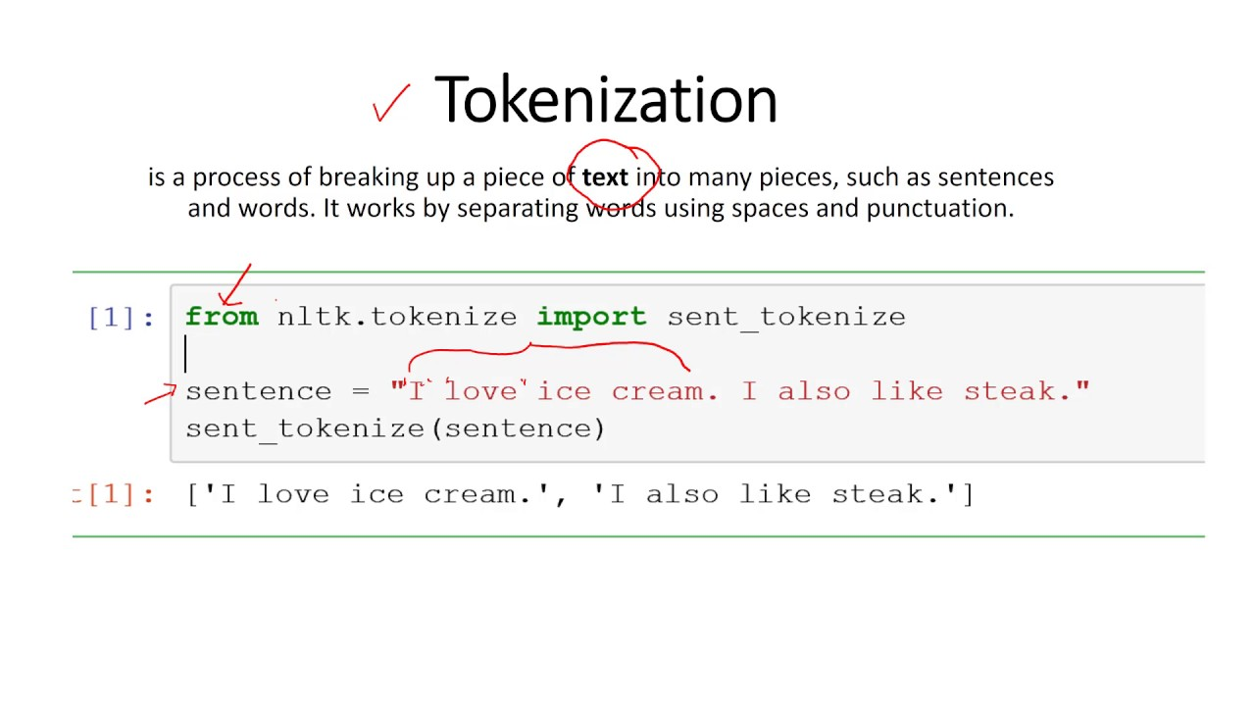
Pre-Processing
Tokenization
Takes a line and provides tokens/words by splitting them using NLTK

Slide 15

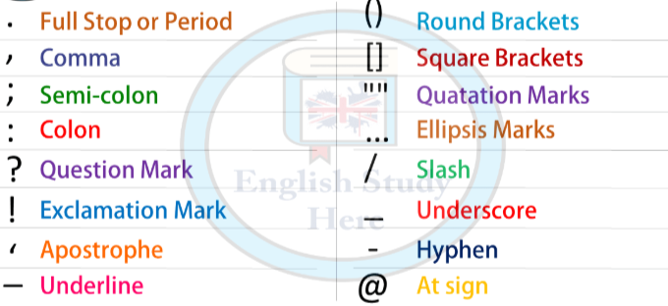
Pre-Processing
Remove Punctuation
Remove all punctuation(? , ; etc.)

Slide 16
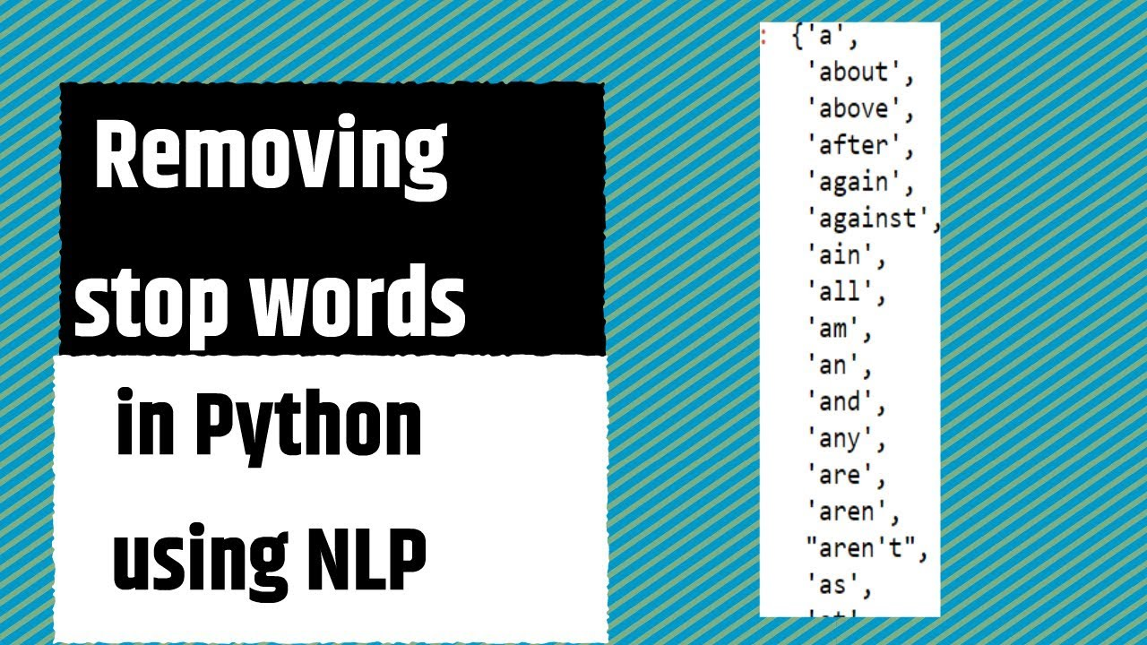
Pre-Processing
Remove stopwords
Remove all stopwords(is, are, and, we, from etc.)

Slide 17

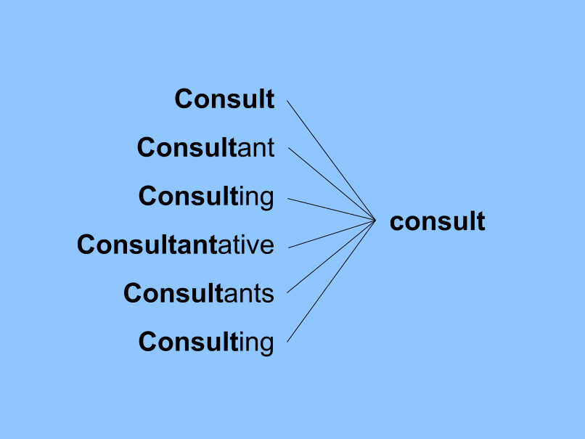
ARTIFICIAL
Pre-Processing
INTELLIGENCE
Stemmer
Used to extract the base form of the words by removing affixes

Slide 18
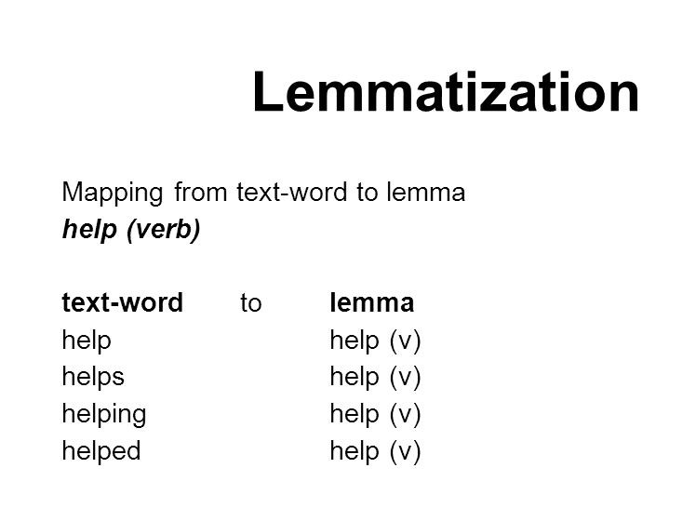

Pre-Processing
Lemmatization
ARTIFICIAL INTELLIGENCE
Remove inflectional endings only and to return the base for of a word.

Slide 19
All Function

Slide 20
Artificial Intelligence
All Function
CountVectorizer ()
Counts the word frequencies and convert to a collection of text documents.
01
Pipeline ()
Used to make an object of classifier where I pass tfidf vectorizer or count vectorizer, multinomialNB and SVM at the same time .
02
TfidfVectorizer ()
Stands for term frequency – inverse document frequency, is a numerical statistic.
Classification report()
03
Determine the precision , recall , f1-score , support , accuracy , macro avg and weighted avg .
Accuracy score ():
Determine the accuracy of the model based on the labels the model.
04
05

Slide 21
Artificial Intelligence
All Function
classifier.fit ()
Passed the train data into the classifier .
classifier.predict ()
Passed test document into the method and the model will predict the labels of the test document .
confusion_matrix()
This function is used to evaluate the performance of the model .

Slide 22
We Also Used Some Function
char_n_gram_ready
Takes space and join the string. It is using for remove punctuation, stopwords etc.
identity(X)
We use a dummy function as tokenizer and preprocessor.
vec_tfidf(tfidf)
We use it for TfidfVectorizer and CountVectorizer.

Slide 23

System Output
Predicted Label
Best Naïve Bayes Accuracy
Best SVM Accuracy

Slide 24
Get a Predicted Test Label
Using this Function
def write_label(prediction):
file = open("datasets/News_Classification/output/predicted_test_label.txt", mode="w")
file.close()
for label in prediction:
file = open("datasets/News_Classification/output/pre dicted_test_label.txt", "a", encoding='utf-8')
file.write(str(label))
file.write("\n")
file.close()
Output
Which is save in our Google drive as predicted_test_label.txt.

Slide 25
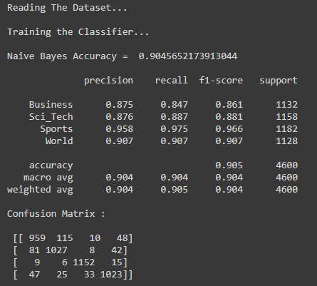
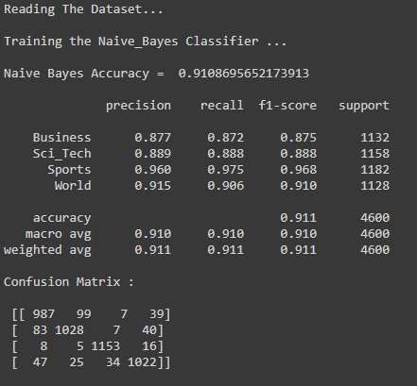
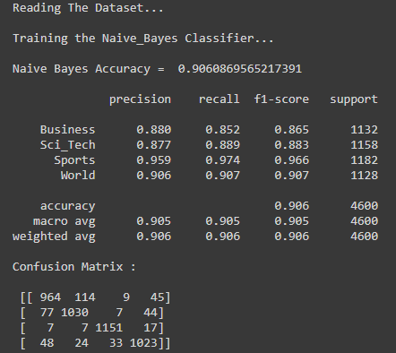
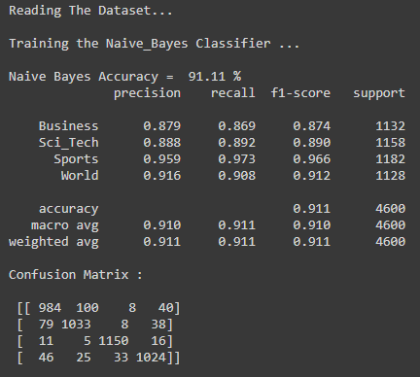
Naive Bayes Several Output
02
01
04
03

Slide 26
Best Naive Bayes Classifier Report
 | precision | recall | f1-score | support
Business | 0.879 | 0.869 | 0.874 | 1132
Sci_Tech | 0.888 | 0.892 | 0.890 | 1158
Sports | 0.959 | 0.973 | 0.966 | 1182
World | 0.916 | 0.908 | 0.912 | 1128
accuracy |  |  | 0.911 | 4600
macro avg | 0.910 | 0.911 | 0.910 | 4600
weighted avg | 0.911 | 0.911 | 0.911 | 4600

Slide 27
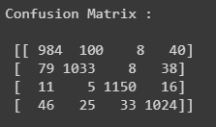
Best Naive Bayes Classifier Report
We Get Result
01
02
03
Reading The Dataset ...
Training the Naive Bayes Classifier ...
Naive Bayes Accuracy = 91.11 %
tfidf = False
('cls', MultinomialNB())
CountVectorizer(ngram_range =(9,9))

Slide 28
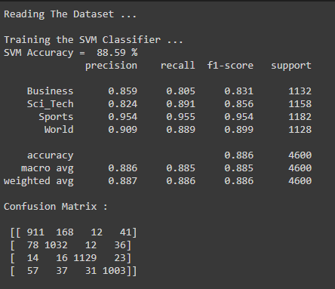
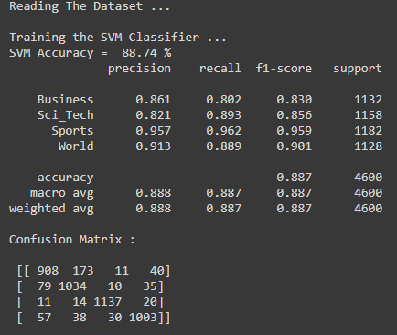
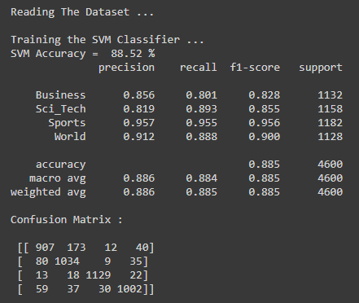
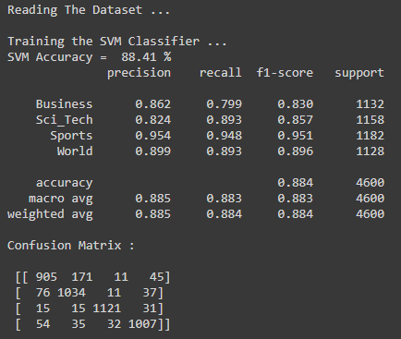
SVM Several Output

Slide 29
Best Support Vector machines Classifier Report
 | precision | recall | f1-score | support
Business | 0.861 | 0.802 | 0.830 | 1132
Sci_Tech | 0.821 | 0.893 | 0.856 | 1158
Sports | 0.957 | 0.962 | 0.959 | 1182
World | 0.913 | 0.889 | 0.901 | 1128
accuracy |  |  | 0.887 | 4600
macro avg | 0.888 | 0.887 | 0.887 | 4600
weighted avg | 0.888 | 0.887 | 0.887 | 4600

Slide 30
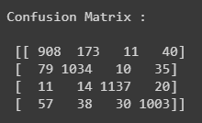
Best Support Vector machines Classifier Report
tfidf = True
SVC(kernel='linear', C=1.0))
TfidfVectorizer(ngram_range = (4,9))
Confusion Matrix
Training the SVM Classifier ...
SVM Accuracy = 88.74 %.

Slide 31
Final Result
Which Classifier is Best for Our Model
Naive Bayes Accuracy = 91.11 %
SVM Accuracy = 88.74 %

Slide 32
Conclusion
In this project, Firstly the News Classification datasets are tokenize and separate the labels and documents with a function call.
Then, different pre-processing method to find out different function. The train.txt data is big so it take more and more time to get output. So, we use 15000 train data for SVM. Changing ngram_range to get a best result.
Finally, this project has been run successfully and performance of the system has been found satisfactory.

Slide 33
News Classification
Thank You

